Slide 2
Enzymatic Processes in Industrial Production & its application

Slide 3


PROTEASES IN BAKING: SOFT COOKIES
Chosen enzyme
PROTEASES
Chosen product
SOFT COOKIES
Proteases are a diverse group of enzymes that break down proteins by catalyzing the hydrolysis (breakdown) of peptide bonds, the bonds that link amino acids together.
They are found in all living organisms, from bacteria to humans, and are essential for fundamental biological processes such as digestion, cell signaling, and the normal functioning of cells and tissues.
Proteases are also widely used in industrial applications like the food, detergent, and pharmaceutical industries.
Soft cookies are a type of cookie known for their tender, moist, and often chewy texture, contrasting with harder, crispier cookies.
They are made with ingredients like a higher ratio of brown sugar to white sugar, moisture-rich components, and often specialty starches and humectants like corn syrup or molasses.
To achieve a soft cookie, a proper balance of ingredients, melted butter, and a shorter, less intense baking time is crucial

Slide 4

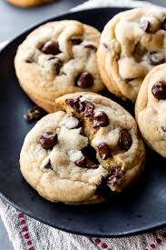
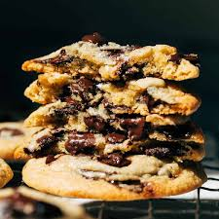
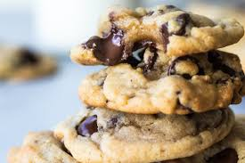
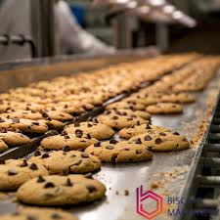
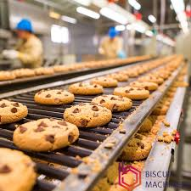
SOFT COOKIES: PICTURE GALLERY WARNING: CAN CAUSE EXTREME CRAVINGS
Cookies produced in factories in huge batches

Slide 5
ROLE OF PROTEASES
How Proteases Improve Cookies?
Gluten Modification: Proteases break down the large protein molecules in the gluten network into smaller pieces.
Dough Softening: This modification makes the dough more extensible, or stretchable, and less elastic, which helps manage dough consistency and prevents tearing when it's rolled thin.
Tender Texture: By weakening gluten bonds, proteases ensure a tender crumb and a softer bite in the finished cookie.
Increased Spread: The relaxation of the gluten matrix allows the cookie to spread more during baking, leading to a larger, more acceptable appearance.
Reduced Toughness: Without proteases, high-protein flour can result in dense, tough cookies. Proteases prevent this by controlling gluten development.
In making cookies, proteases act as baking improvers by modifying the gluten network in flour to create a softer, more tender texture. They break down proteins, which relaxes and weakens the gluten, preventing a tough, dense final product. This enzymatic action increases the cookie's spread, enhances its appearance, and produces a desirable, tender mouthfeel, especially in shortbread and other soft-cookie varieties.

Slide 6
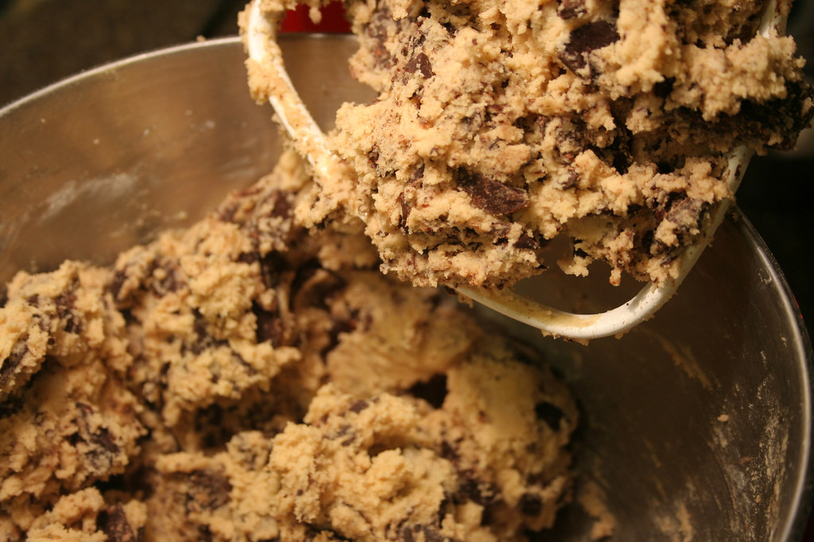
PROCESS OF MAKING COOKIES WITH PROTEASES AND REQUIRED CONDITIONS
To make cookies with proteases, incorporate the enzyme into the flour before or during mixing, aiming to partially hydrolyze gluten proteins to alter dough properties like tenderness and spread. Required conditions involve selecting an appropriate commercial protease, like Biobake or Neutrase, adding it at a specific ppm concentration (e.g., 30-90 ppm), and optimizing the standard cookie-making process to manage the enzyme's effects on dough texture and the final cookie.
IMPORTANT CONDITIONS:
Type of enzyme: essentially BIOBAKE or NEUTRASE or any other with concentration 30,60 or 90 ppm
Optimal pH should be 5-6(slightly acidic environment)
Bake at standard temperature i.e. 180 degree celcius and while dough mixing, 30-40 degrees
Be mindful of over-mixing as it can damage the gluten network
Mix the enzyme in before or during the dough preparation NOT AS A LAST MINUTE ADDITION

Slide 7



INDUSTRIAL APPLICATION
Improved Dough Handling: Reduces stickiness and improves machinability
Increased Cookie Spread: Creates larger diameter cookies with even thickness
Texture Control: Enables production of consistently soft, chewy cookies
Shelf-life: Can affect moisture retention and prevent hardening
KEY BENEFITS
Process Efficiency
Reduced mixing time and improved production throughput
Quality Consistency
Uniform texture and appearance across production batches
Texture Customization
Adjustable enzyme levels for different product specifications

Slide 8




COMPUTER ENGINEERING IN FOOD INDUSTRY
Process Automation & Control
Automated temperature, humidity, and time control for consistent baking conditions
Precise enzyme dosage systems for optimal protease activity
Real-time adjustments based on dough properties
Smart Sensors & Monitoring
Real-time pH and moisture monitoring for optimal enzyme activity
Texture analysis sensors for consistent cookie softness
Vision systems for quality control and uniformity
Simulation & Modeling
Computer modeling of enzyme kinetics in dough systems
Optimization of production parameters via digital twins
Virtual testing of new formulations before scale-up
Emerging Technologies
AI algorithms predict optimal enzyme activity conditions
IoT-connected equipment for centralized process control
Blockchain for ingredient traceability and quality assurance
Integration with Enzymatic Processes
Computer engineering technologies enable precise control of enzymatic reactions in food production, allowing manufacturers to optimize protease activity for ideal cookie texture while maintaining consistency across production batches and reducing waste.

Slide 9
BIBLIOGRAPHY
https://www.google.com/url?sa=i&url=https%3A%2F%2Fwww.culinaryhill.com%2Fsoft-chocolate-chip-cookies%2F&psig=AOvVaw0MnbNMx9pfcr1E8rJCTXP5&ust=1757334270530000&source=images&cd=vfe&opi=89978449&ved=0CBUQjRxqFwoTCOiEt9PSxo8DFQAAAAAdAAAAABAE
https://www.google.com/imgres?q=what%20are%20soft%20cookies&imgurl=https%3A%2F%2Fsallysbakingaddiction.com%2Fwp-content%2Fuploads%2F2012%2F08%2Fwarm-chocolate-chip-cookies.jpg&imgrefurl=https%3A%2F%2Fsallysbakingaddiction.com%2Fchocolate-chip-cookies%2F&docid=F4EDCIc0nlgM5M&tbnid=H_P7timLlyxb4M&vet=12ahUKEwjyuqe40saPAxXE2TgGHXgDBGAQM3oECCcQAA..i&w=1200&h=1800&hcb=2&ved=2ahUKEwjyuqe40saPAxXE2TgGHXgDBGAQM3oECCcQAA
https://www.google.com/imgres?q=Soft%20cookies%20industry%20production&imgurl=https%3A%2F%2Fwww.biscuitmachinery.com%2Fwp-content%2Fuploads%2F2022%2F06%2Fyooopaaa_29357_Chocolate_chip_cookie_production_line_f9ce2176-96ca-4191-8e64-40f5b858ec27.png&imgrefurl=https%3A%2F%2Fwww.biscuitmachinery.com%2F2333&docid=udUhysNFdesvsM&tbnid=P9uSPJEiNIQJQM&vet=12ahUKEwi4nKyI08aPAxVe1jgGHUsFHv0QM3oECBkQAA..i&w=1024&h=1024&hcb=2&ved=2ahUKEwi4nKyI08aPAxVe1jgGHUsFHv0QM3oECBkQAA
https://www.google.com/url?sa=i&url=https%3A%2F%2Fwww.biscuitmachinery.com%2F2365&psig=AOvVaw22I3wmZL7dPrF4SLlZNs-9&ust=1757334438620000&source=images&cd=vfe&opi=89978449&ved=0CBUQjRxqFwoTCOi9qs7Txo8DFQAAAAAdAAAAABAE
https://www.biolaxienzymes.com/how-amylases-and-proteases-enhance-flour-performance-in-baking/#:~:text=The%20Role%20of%20Proteases,minimal%20gluten%20development%20is%20preferred.
https://www.sciencedirect.com/science/article/abs/pii/S0963996904002388#:~:text=Some%20cookie%20producers%20use%20chemical,Wakeren%20&%20Popper%2C%202004).

Slide 10
THANKYOU

